Slide 1



Maven and friends
Session
7
Chaim Turkel
Ido Barash

Slide 2


Last session - JEE
What is Java EE?
Specifications
JCP
JEE components
n-tier architecture
JEE Containers
Application servers
Deployment
Servlets specification

Slide 3
Maven
What is Maven
Maven architecture
Project structure conventions
Building with Maven
Repository servers (Artifactory)
Continues integration build (Jenkins)

Slide 4

What is Maven?
Apache Maven is a software project management and build tool.
Manages dependencies (3rdf party Jars).
Manages project’s build cycle.
Manages documentations.
Provide project structure guideline.
Plugin oriented – easy to extends
Maven was chosen by the JCP as the leading build tool (took ant’s place)

Slide 5
Maven architecture
Artifacts are the corner-stone of maven projects.
Each deployment entity (Jar, War, Ear) is an artifact.
Each artifact depends on other artifacts (3rd party Jars).
Each artifact has 3 distinguish characteristics: GroupId: com.sapiens.alis ArtifactId: foundation Version: 1.2.14_SNAPSHOT

Slide 6
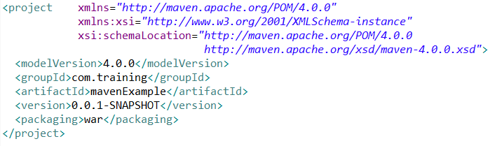
Maven architecture
Each project has “pom.xml” file which used by maven to describe its own artifact data, which artifacts it needs to use, how it is packaged and how it is built.
“Pom” stands for Project Object Model
Basic pom.xml:

Slide 7
Maven architecture
All projects uses 3rd party dependencies.
Managing them can be a mess.
Knowing exactly which versions of 3rd parties are used in each project is hard.
Every project is stored in the SVN with all it’s Jars in it’s “lib” folder. This causes enormous duplications:

Slide 8




Maven architecture
Problem: Jars and dependencies.
SL trunk
SL brunch
PL trunk
Decision trunk
SVN
log4j-1.2.15.jar
log4j-1.2.15.jar
log4j-1.2.15.jar
log4j-1.2.15.jar
Orit
Orit
Yair
SL trunk
SL trunk
SL brunch
Decision trunk
Andrey
SL trunk
PL trunk
PL trunk
PL brunch

Slide 9
Maven architecture
Problem: Jars and dependencies.
SL trunk
SL brunch
PL trunk
Decision trunk
SVN
log4j-1.2.15.jar
log4j-1.2.15.jar
log4j-1.2.15.jar
log4j-1.2.15.jar
Orit
Orit
Yair
SL trunk
log4j-1.2.15.jar
SL trunk
SL brunch
log4j-1.2.15.jar
log4j-1.2.15.jar
Decision trunk
log4j-1.2.15.jar
Andrey
PL trunk
SL trunk
log4j-1.2.15.jar
log4j-1.2.15.jar
PL trunk
PL brunch
log4j-1.2.15.jar
log4j-1.2.15.jar

Slide 10
Maven architecture
Problem: Jars and dependencies.
SL trunk
SL brunch
PL trunk
Decision trunk
SVN
log4j-1.2.15.jar
log4j-1.2.15.jar
log4j-1.2.15.jar
log4j-1.2.15.jar
How many copies of log4j-1.2.15.jar ?
N copies in the SVN server
+
N copies in my computer
+
N copies in your computer
------------------------------------
Number of projects * number of computers
Orit
Orit
Yair
SL trunk
log4j-1.2.15.jar
SL trunk
log4j-1.2.15.jar
SL brunch
log4j-1.2.15.jar
Decision trunk
Andrey
log4j-1.2.15.jar
SL trunk
PL trunk
log4j-1.2.15.jar
log4j-1.2.15.jar
PL trunk
PL brunch
log4j-1.2.15.jar
log4j-1.2.15.jar

Slide 11
Maven architecture
Jars are copied way to many times.
Lib folders can easily become very big.
Jars are binaries – you can not use SVN to compare or merge them. So there is no advantage of storing them in the SVN.
This is well noticed on update and checkout.

Slide 12
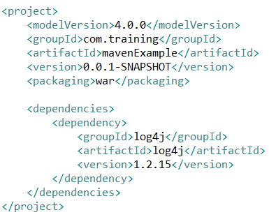
Maven architecture
In the pom we list the dependencies and 3rd party jars we use:
Maven will automatically download the log4j 1.2.15 Jar to a local repository on the developer’s machine.

Slide 13
Maven architecture
When maven adds a 3rd party dependency it first looks for it in a local repository located in a hidden folder:
This repository holds jars used buy any maven managed project on this machine.
If the dependency was not found – maven tries to download it from a repository in the local network (Company Jars)
Finally, if the dependency was not found, Maven will try to fetch it from a worldly general repository (cloud).
Linux|mac: ~/.m2 Windows: C:\Users\<user_name>\.m2

Slide 14





Maven architecture
Now using maven:
SL trunk
SL brunch
PL trunk
Decision trunk
SVN
Pom.xml
Pom.xml
Pom.xml
Pom.xml
Orit
log4j-1.2.15.jar
Maven Repository
Orit
Yair
SL trunk
Pom.xml
SL brunch
SL trunk
Pom.xml
Pom.xml
How many copies of log4j-1.2.15.jar ? 1 on a Maven repository (Not SVN)
+
1 on my computer
+
1 on your computer
------------------------------------------------
Number of computers + repository
log4j-1.2.15.jar
Decision trunk
Pom.xml
Andrey
Orit
PL trunk
SL trunk
Pom.xml
Pom.xml
PL Trunk
PL brunch
Pom.xml
Pom.xml
log4j-1.2.15.jar
log4j-1.2.15.jar

Slide 15
Maven architecture
Exercise:
Create a new maven WAR project: group: com.training artifact: mavenProject
Add new dependency: facebook java api 2.0
Make sure it was downloaded and present in the /users/{userName}/.m2/repository folder.
Create new class: com.training.TestClass and create new instance of FacebookException

Slide 16
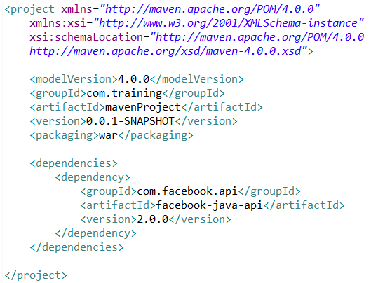
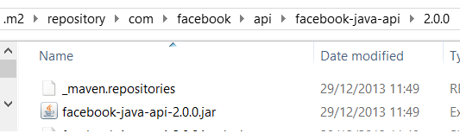
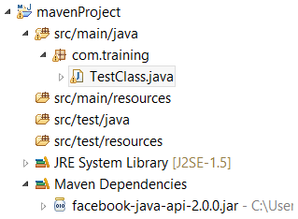
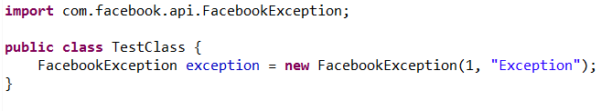
Maven architecture
Exercise:

Slide 17
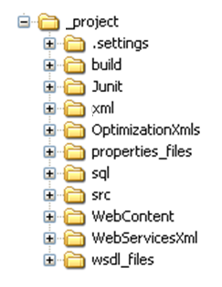

Project structure conventions
Problem: Every project holds different packages structure.

Slide 18
Project structure conventions
Problem: Every project holds different packages structure.
Where are the tests?

Slide 19
Project structure conventions
Problem: Every project holds different packages structure.
Where are the tests?

Slide 20
Project structure conventions
Problem: Every project holds different packages structure.
Where are the tests?
Where are the configuration files and the resources?

Slide 21
Project structure conventions
Problem: Every project holds different packages structure.
Where are the tests?
Where are the configuration files and the resources?

Slide 22
Project structure conventions
Every project is different
For fast development – Order and simple structure are very crucial.
Conventions enforce order on every developer
Diving into the code of a new project gets easier.

Slide 23
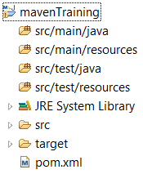
Project structure conventions
Project structure:

Slide 24
Project structure conventions
Project structure:
Actual classes and source files

Slide 25
Project structure conventions
Project structure:
Actual classes and source files
Resources and configuration

Slide 26
Project structure conventions
Project structure:
Actual classes and source files
Resources and configuration
Unit-tests

Slide 27
Project structure conventions
Project structure:
Actual classes and source files
Resources and configuration
Unit-tests
Resources needed and used by Unit-tests

Slide 28
Project structure conventions
Project structure:
Actual classes and source files
Resources and configuration
Unit-tests
Resources needed and used by Unit-tests
Jars and 3rd party dependencies

Slide 29
Project structure conventions
Project structure:
Actual classes and source files
Resources and configuration
Unit-tests
Resources needed and used by Unit-tests
Jars and 3rd party dependencies
Webapp and webcontent folders

Slide 30
Project structure conventions
Project structure:
Actual classes and source files
Resources and configuration
Unit-tests
Resources needed and used by Unit-tests
Jars and 3rd party dependencies
Webapp and webcontent folders
Build folder which in it the Jar/War/Ear will be created

Slide 31
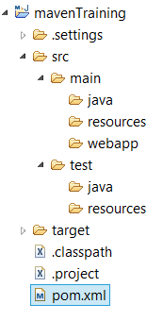
Project structure conventions
Project structure (file system):

Slide 32
Project structure conventions
Project structure (file system):
Actual classes and source files
Resources and configuration
Webapp and webcontent folders
Unit-tests
Resources needed and used by Unit-tests
Build folder which in it the Jar/War/Ear will be created including all the dependencies

Slide 33
Building with Maven
Maven controls the build process of the project.
Build process is called “life-cycle”
There are 3 life-cycles:
Default
Clean (clean the project only – build nothing)
Site (Reporting only)
Each life-cycle contains phases.
Each phase contain goals.

Slide 34
Building with Maven
Default life-cycle:
Validate
Compile
test
package
install
deploy

Slide 35
Building with Maven
Default life-cycle:
Validate Validate whether project is correct and all necessary information is available.
Compile
test
package
install
deploy

Slide 36
Building with Maven
Default life-cycle:
Validate Validate whether project is correct and all necessary information is available.
Compile Compile the source code.
test
package
install
deploy

Slide 37
Building with Maven
Default life-cycle:
Validate Validate whether project is correct and all necessary information is available.
Compile Compile the source code.
test Run tests using testing framework (JUnit)
package
install
deploy

Slide 38
Building with Maven
Default life-cycle:
Validate Validate whether project is correct and all necessary information is available.
Compile Compile the source code.
test Run tests using testing framework (JUnit)
package Wrap the compiled code with a JAR / WAR or EAR
install
deploy

Slide 39
Building with Maven
Default life-cycle:
Validate Validate whether project is correct and all necessary information is available.
Compile Compile the source code.
test Run tests using testing framework (JUnit)
package Wrap the compiled code with a JAR / WAR or EAR
install Install the package to the local m2 repository, so it could be used as a dependency in other projects.
deploy

Slide 40
Building with Maven
Default life-cycle:
Validate Validate whether project is correct and all necessary information is available.
Compile Compile the source code.
test Run tests using testing framework (JUnit)
package Wrap the compiled code with a JAR / WAR or EAR
install Install the package to the local m2 repository, so it could be used as a dependency in other projects.
deploy Copy the final artifact to the remote repository.

Slide 41

Building with Maven
To build with maven, use “mvn” command at the root of the project and provide phase/s.
Clean Will delete the content of the target folder.
Install Will run phases up to install phase (“validate”, “compile”, “test”, “package” and “install”.

Slide 42
Building with Maven
To build with maven, use “mvn” command at the root of the project and provide phase/s.
Clean Will delete the content of the target folder.
Install Will run phases up to install phase (“validate”, “compile”, “test”, “package” and “install”.
If a phase fails – build stops.

Slide 43
Building with Maven
Build process can be more complicated and some times we need to perform extra actions like copy files, compile other languages, deploy to remote web servers, etc…
Plug-in is an artifact that is activated during the build process.
A plug-in has goals which can perform anything we want and can be attached to a specific phase.
Plug-ins are Java classes – and it is not to complicated to wrote on our own.

Slide 44
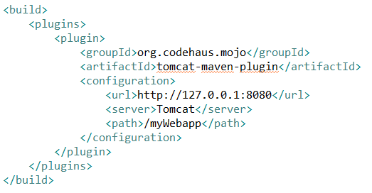
Building with Maven
Deploy to tomcat:

Slide 45
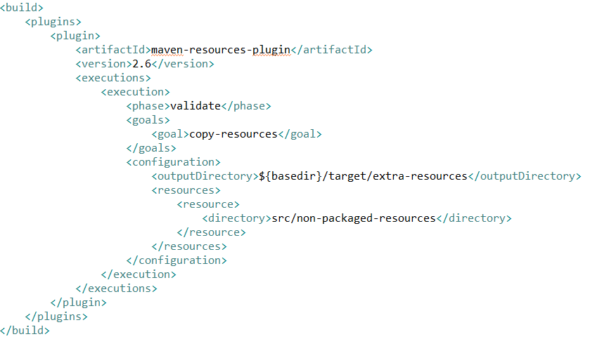
Building with Maven
Copy resources

Slide 46
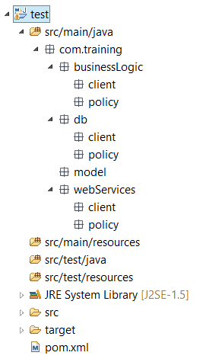
Multi-module project
Usually, we separate different layers to different packages.

Slide 47
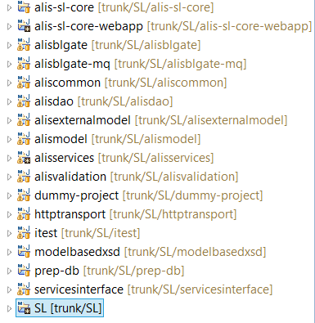
Multi-module project
Maven best practice – Divide to different projects and create dependencies between them.

Slide 48
Multi-module project
Why should we use multi modules project instead of normal packages separation?

Slide 49
Multi-module project
Why should we use multi modules project instead of normal packages separation?
Each project has it’s own POM and version. We can use different versions for different parts of the project.
Same project can be used as a dependency for several project (useful with model classes and utilities).
Testing each project on it’s own.
Central dependency management.

Slide 50


Repository servers
Maven architecture uses an internal company repository server
This repository stores all the company specific artifacts, dependencies and their versions.
Repositories servers:

Slide 51
Continuous Integration Build
Working in a team can cause problems.
Something one developer commits a feature he wrote. The developer tested the feature and decided it is working fine. But what if the new feature code changes another feature’s code ?!
This is a serious problem which causes a lot of regression and quality problems.
Continuous Integration is a process

Slide 52


Continues Integration Build
Working in a team can cause problems:
Two developers working on two features:
Maria
Tom

Slide 53



Continues Integration Build
Working in a team can cause problems:
Two developers working on two features:
Maria
Tom
Working on
Clients feature

Slide 54

Continues Integration Build
Working in a team can cause problems:
Two developers working on two features:
Maria
Tom
Working on
Working on
Payments feature
Clients feature

Slide 55

Continues Integration Build
Working in a team can cause problems:
Two developers working on two features:
Maria
Tom
Working on
Working on
Clients feature
Payments feature
Uses
Uses
Clients DB handler

Slide 56
Continues Integration Build
Working in a team can cause problems:
Two developers working on two features:
Maria
Tom
Testing
Working on
Clients feature
Payments feature
Uses
Uses
Clients DB handler

Slide 57
Continues Integration Build
Working in a team can cause problems:
Two developers working on two features:
Maria
Tom
Testing
Working on
Clients feature
Payments feature
Working on
Uses
Uses
Clients DB handler

Slide 58
Continues Integration Build
Working in a team can cause problems:
Two developers working on two features:
Maria
Tom
OK
Working on
Clients feature
Payments feature
Working on
Uses
Uses
Clients DB handler

Slide 59
Continues Integration Build
Working in a team can cause problems:
Two developers working on two features:
Testing
Maria
Tom
Commit
Clients feature
Payments feature
Uses
Uses
Clients DB handler

Slide 60
Continues Integration Build
Working in a team can cause problems:
Two developers working on two features:
OK
Maria
Tom
Clients feature
Payments feature
Uses
Uses
Clients DB handler

Slide 61
Continues Integration Build
Working in a team can cause problems:
Two developers working on two features:
Maria
Tom
Commit
Commit
Clients feature
Payments feature
Uses
Uses
Clients DB handler

Slide 62
Continues Integration Build
Working in a team can cause problems:
Two developers working on two features:
Maria
Tom
Clients feature
Payments feature
Uses
Uses
Clients DB handler

Slide 63
Continues Integration Build
Solution - Continues Integration:
Build the entire project using maven on a central server.
Run tests – if something went wrong notify developers.
Nightly-build: Builds the entire project over night. Each morning developers check results and fix failures.
Continues-build: Builds the entire project on every sources change. Immediate failures notify.

Slide 64




Continues Integration Build
Continues build server is just a scheduler.
Updates new changes from the source control server.
Build project with maven.
Deploy to application servers if needed.
Notes:
64

Slide 65
Maven
What is Maven
Maven architecture
Project structure conventions
Building with Maven
Repository servers (Artifactory)
Continues integration build (Jenkins)

Slide 66
Next session – Spring IOC
Introduction to Spring
Spring core
Inversion Of Control
Bean injection using Spring
Spring IOC annotations
Annotations vs XML
Session
8

Slide 67

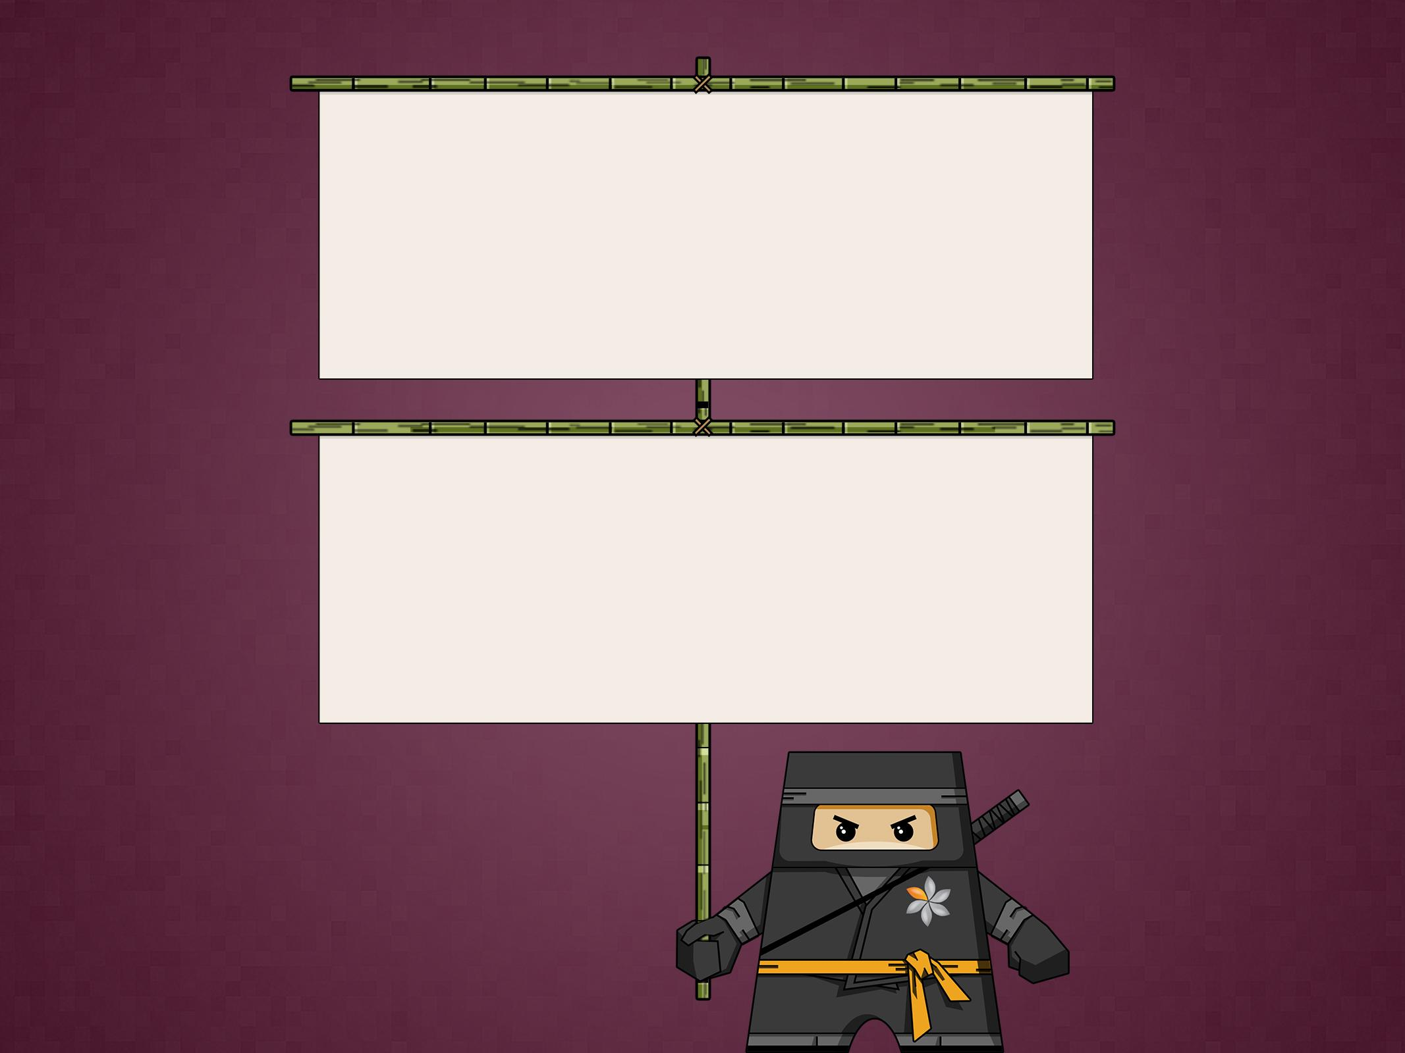
THANK YOU
Ido Barash
Email: ido.barash@tikalk.com

